Slide 1
CSE 2217: Data Structure and Algorithms-II
The Greedy Algorithmic Strategy

Slide 2
We have been solving optimization problems
We have seen that optimization problems are solved in several steps
There are different ways in which we can solve optimization problems:
Dynamic Programming
Greedy Method
Branch and Bound

Slide 3
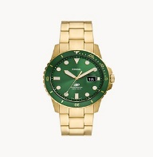
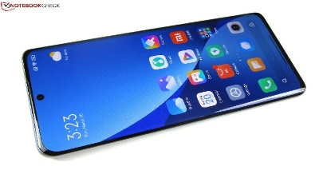
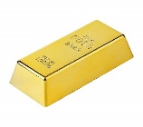
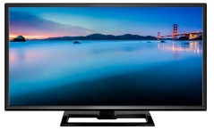
Recall the 0/1 Knapsack Problem
$ 4
$ 5
$ 6
k(5,4)
$ 3
2 Kg
3 Kg
4 Kg
5 Kg
0
6
k(5,3)
k(0,3)
5
0
k(5,2)
k(1,2)
0
4
0
k(5,1)
k(2,1)
k(1,1)
4
0
3
0
3
0
3
k(5,0)
k(3,0)
k(2,0)
k(0,0)
k(1,0)
k(1-2,0)
k(1-3,1)
0
0
0
0
0

Slide 4
Recall the 0/1 Knapsack Problem
$ 4
$ 5
$ 6
k(5,4)
$ 3
2 Kg
3 Kg
4 Kg
5 Kg
0
6
k(5,3)
k(0,3)
Observe:
K(5,3) was not being greedy
No immediate choices were made
Rather it waited for the values from the subproblems
5
0
k(5,2)
k(1,2)
0
4
0
k(5,1)
k(2,1)
k(1,1)
4
0
3
0
3
0
3
k(5,0)
k(3,0)
k(2,0)
k(0,0)
k(1,0)
k(1-2,0)
k(1-3,1)
0
0
0
0
0

Slide 5
An elementary difference between DP and Greedy
The DP Approach
20
10
Note that, no immediate choice is made.
We are waiting for the values from the subproblems
2
1
15
1
1
1
1
1

Slide 6
An elementary difference between DP and Greedy
The DP Approach
26
3
20
10
16
Note that, no immediate choice is made.
We are waiting for the values from the subproblems
1
1
1
1
1
2
15
1
1
1
1
1

Slide 7
An elementary difference between DP and Greedy
The Greedy Approach
20
10
At each stage, the best action is determined based on
the info available.
And only that best action is explored.
2
1
1

Slide 8
An elementary difference between DP and Greedy
23
The Greedy Approach
20
3
At each stage, the best action is determined based on
the info available.
And only that best action is explored.
1
2
1

Slide 9
Application of Greedy
We will see some problems where Greedy works better than Dynamic Programming.
Activity Selection Problem
Fractional Knapsack problem
Huffman Coding
We will also see some cases where Greedy DOES NOT work.
0/1 Knapsack problem
Coin change problem

Slide 10

The First problem: The Activity Selection Problem
Activities (with start time and finish time) are given sorted by the finish time. We need to select the maximum number of activities.
You can imagine each activity as the start and end time of movies at Cineplex.

Slide 11
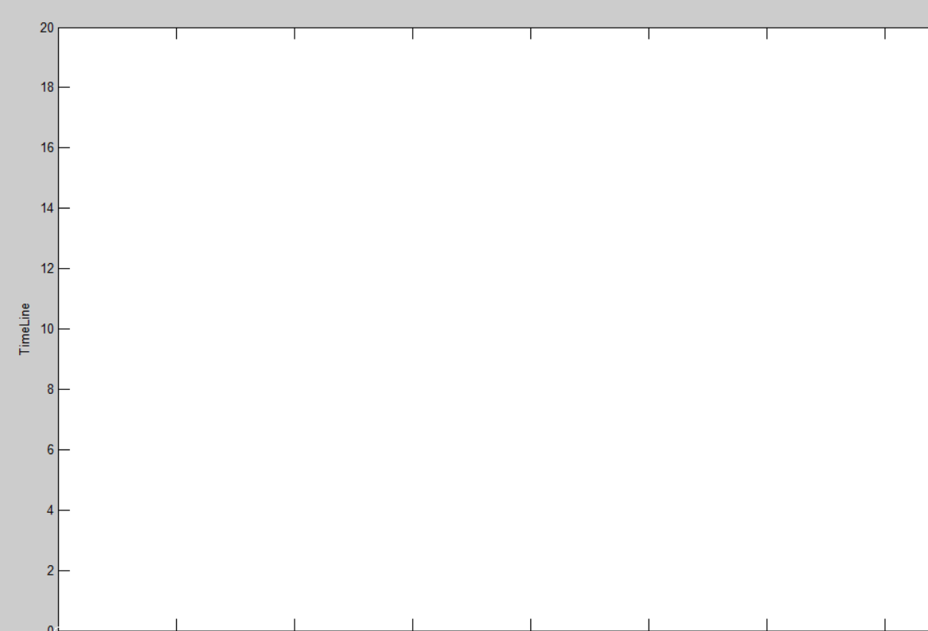
Timeline
a11
12-16
a10
2-14
a9
a8
a7
8-12
a6
8-11
a5
6-10
3-9
5-9
a4
a3
5-7
a2
0-6
a1
3-5
1-4

Slide 12
The First problem: The Activity Selection Problem
Example of non -overlapping activities : a3, a9, a11

Slide 13
The First problem: The Activity Selection Problem
The max number of non-overlapping activities
a1, a4, a8, a11

Slide 14
S:
1
3
0
5
8
5
Not In Syllabus
F()
F:
2
4
6
7
9
9
F(a0,a1)
a0
a1
a2
a3
a4
a5
a5
F(a0,a1,a2,a3,a5,a5)
a4
a0
a1
F(a0,a1,a2,a3)
F()
a3
F()
F(a1,a3,a4,a5)
F(a0)
F(a3,a4,a5)
a2
F(a0,a1)
F(a4)
a1
a3
a4
a5
F()
F(a3,a4,a5)
F(a1,a3)
F()
F(a1)
F()
F()
F(a4)
F(a1)
F(a5)
a5
a3
a4
F()
F(a4)
F(a3)
F()
F()
F()

Slide 15
S:
1
3
0
5
8
5
Not In Syllabus
F()
F:
2
4
6
7
9
9
F(a0,a1)
a0
a1
a2
a3
a4
a5
(a0,a1,a3,a4)
(a0,a1,a5)
a5
F(a0,a1,a2,a3,a5,a5)
(a0,a1,a3,a4,)
(a0,a1,a3,a4)
(a0,a1,a3,a4,)
a4
a0
(a0,a1,a3,a4)
(a2,a4)
a1
F(a0,a1,a2,a3)
F()
(a1,a3,a4)
(a3,a4)
a3
a0
F()
F(a1,a3,a4,a5)
a1,a5
F(a0)
F(a3,a4,a5)
a2
(a1,a3,a4)
(a1,a3,a4)
F(a0,a1)
F(a4)
(a1,a3,a5)
a1
a3
a4
a5
(a3,a4)
F()
F(a3,a4,a5)
F(a1,a3)
F()
F(a1)
F()
F()
F(a4)
F(a1)
F(a5)
(a3,a4)
(a3,a4)
a5
a5
a3
a4
F()
F(a4)
F(a3)
F()
F()
F()

Slide 16
Problems with this approach
Several recursive calls from a recursive function.
Difficult to use memoization

Slide 17
Lets move on to the Greedy strategy of Greedy
As we saw, we have to solve many recursive problems
How can we reduce our work (i.e solve this problem by making less choices?)
Now let’s think greedily.
We are trying to select the maximum possible activities that do not overlap.
Let us reframe the problem

Slide 18
Lots of overlapping tasks
Task1 (1-4)
Task5(3-9)
Task9(8-12)
Task2(3-5)
Task6(5-9)
Task10(2-14)
Task3(0-6)
Task7(6-10)
Task11(12-16)
Task4(5-7)
Task8(8-11)

Slide 19
Lets move on to the Greedy strategy
We need to select activities, that can leave out more time for the other activities.
That is the best activity to select at a time is the one that has the earliest finish time at the moment
This has to be the first activity (after being sorted as per finish time)
Choosing out the first activity with the earliest finish time will leave out more room for other activities
Thus we can frame the function like this:
S(1,n)=1+S(x,n)
X is a non-overlapping activity that does not overlap with activity 1
And it is the non-overlapping activity with the earliest finish time

Slide 20
Timeline
a11
12-16
a10
2-14
a9
a8
a7
8-12
a6
8-11
a5
6-10
3-9
5-9
a4
a3
5-7
a2
0-6
a1
3-5
1-4

Slide 21
Finishes later
Note: The activities are sorted as
per their finish time.
S(1,n)
a1
a3
a2
S(4,n)
………….
a4
a11
a5
………….
S(8,n)

Slide 22
The activity selection problem
4
{a1,a3,a8,a11}
S(1,n)
1
a1
3
{a3,a8,a11}
S(4,n)
1
a4
2
{a8,a11}
S(8,n)
1
a8
1
{a11}
S(11,n)
1
a11
0
S(12,n)

Slide 23
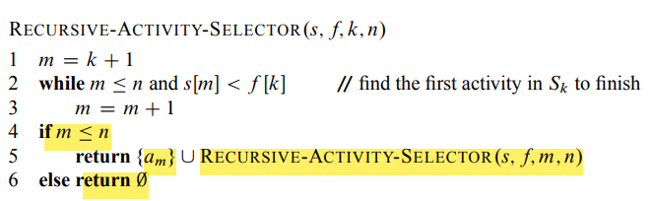
The Recursive Equation

Slide 24
Activity-Selection Problem Greedy Approach
i
i
i
i
i
i
i
i
i
i
i | 1 | 2 | 3 | 4 | 5 | 6 | 7 | 8 | 9 | 10 | 11
start | 1 | 3 | 0 | 5 | 3 | 5 | 6 | 8 | 8 | 2 | 12
end | 4 | 5 | 6 | 7 | 9 | 9 | 10 | 11 | 12 | 14 | 16
k
k
k
k

Slide 25
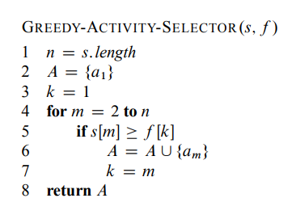
The Greedy Activity Selection

Slide 26
Two properties for applying greedy algorithm
Greedy Choice Property
Optimal Substructure property
Let us check if they exist for the current problem.

Slide 27
Optimal Substructure Property
4
{a1,a3,a8,a11}
S(1,n)
1
a1
3
{a3,a8,a11}
S(4,n)
12-16
2-14
1
a4
2
{a8,a11}
8-12
S(8,n)
8-11
6-10
3-9
5-9
1
a8
1
{a11}
5-7
S(11,n)
0-6
3-5
1-4
1
a11
0
S(12,n)

Slide 28
Optimal Substructure Property
S(0,n)
S(1,n) will have the higher
number of activities
a1
a3
a2
S(4,n)
………….
If its sub problem(3,n)
returns the highest number
of activities
a11
a4
a5
………….
S(8,n)

Slide 29
Greedy Choice Property
4
{a1,a3,a8,a11}
S(0,n)
1
a1
3
{a3,a8,a11}
S(3,n)
1
a4
2
{a8,a11}
S(7,n)
1
a8
1
{a11}
S(10,n)
1
a11
0
S(12,n)

Slide 30
Greedy Choice Property
{aj ,ax , ay, az}
Let am be the activity that has
the earliest finish time.
S(0,n)
And we call the recursive function
S(0,n)
aj
…
We get a set of activities
{aj ,ax , ay, az}
…
THUS, there is no harm if
we make choices greedily.
We can still optimize.
S(i,n)
If aj and am are the same activity,
Then great. It is as expected.
…
For this particular problem
However, if aj and am are different,
Then we can easily replace aj with am,
Because …
Thus , this problem has
Greedy choice property.

Slide 31
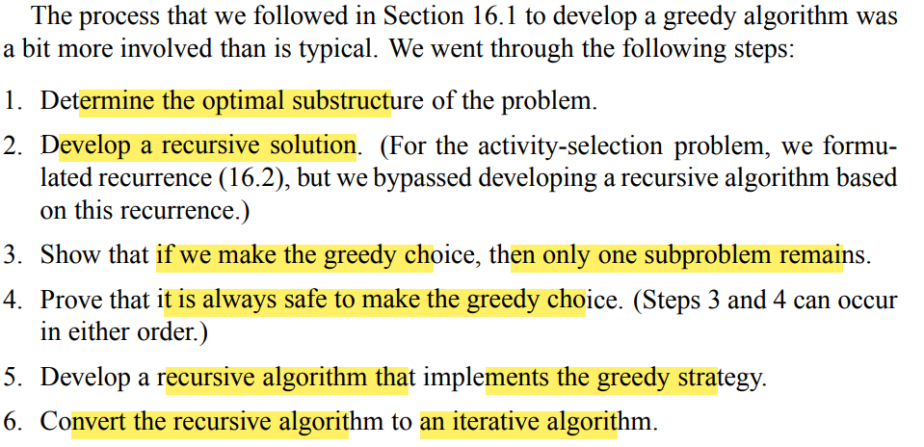
How we have tackled the last problem using the Greedy Approach
Prove that the problem has optimal
substructure property.
2. Develop a recursive solution.
3. Reframe the problem so that it
can be solved by greedy.
4. Prove that it has greedy choice
property .
5. Develop the recursive greedy algorithm
6. Develop the iterative greedy algorithm

Slide 32
However, the two most important things to consider when trying to solve a problem with greedy
Prove that the problem has optimal
substructure property.
2. Develop a recursive solution.
3. Reframe the problem so that it
can be solved by greedy.
4. Prove that it has greedy choice
property .
5. Develop the recursive greedy algorithm
6. Develop the iterative greedy algorithm

Slide 33
Thank You

